Slide 1
Service-Oriented Architecture
Lecturer: Ngo Huy Bien
Software Engineering Department
Faculty of Information Technology
VNUHCM - University of Science
Ho Chi Minh City, Vietnam
nhbien@fit.hcmus.edu.vn

Slide 2

Objectives

Slide 3

Contents
Service-Oriented Computing
Service-Oriented Architecture

Slide 4

References
M.P. Papazoglou and D. Georgakopoulos (2003). Service-Oriented Computing.
Mark Endrei et al. (2004). Patterns - Service-Oriented Architecture and Web Services. IBM Corp.
Hye-young Paik et al. (2017). Web Service Implementation and Composition Techniques. Springer.
Thomas Erl (2005). Service-Oriented Architecture - Concepts Technology and Design. Prentice Hall PTR.

Slide 5
Service-Oriented Computing [1]
Services are self-describing, open components that support rapid, low-cost composition of distributed applications.
Services are offered by service providers—organizations that procure the service implementations, supply their service descriptions, and provide related technical and business support.
Service-oriented computing (SOC) is the computing paradigm that utilizes services as fundamental elements for developing applications.

Slide 6
Service Descriptions
Service descriptions are used to advertise the service capabilities, interface, behavior, and quality.
The service capability description states the conceptual purpose and expected results of the service (by using terms or concepts defined in an application-specific taxonomy).
The service interface description publishes the service signature (its input/output/error parameters and message types).
The (expected) behavior of a service during its execution is described by its service behavior description (for example, as a workflow process).
The Quality of Service (QoS) description publishes important functional and nonfunctional service quality attributes, such as service metering and cost, performance metrics(response time, for instance), security attributes,(transactional) integrity, reliability, scalability, and availability.

Slide 7
Service Clients
Service clients are end-user organizations that use some service.
Service aggregators are organizations that consolidate multiple services into a new, single service offering.
Service aggregators develop specifications and/or code that permit the composite service to perform functions that include:
Coordination: The execution of the component services, Dataflow.
Monitoring: Events or Information produced by the component services.
Conformance: Matching its parameter types with those of its components, constraints on the component services.
Quality of Service (QoS) composition: The composite service’s overall cost, performance, security, authentication, privacy, (transactional) integrity, reliability, scalability, and availability.

Slide 8
Service-Oriented Architecture [2]
Service-oriented architecture presents an approach for building distributed systems that deliver application functionality as services to either end-user applications or other services.
SOA represents an open, agile, extensible, federated, compostable architecture comprised of autonomous, QoS-capable, vendor diverse, interoperable, discoverable, and potentially reusable services.

Slide 9
Service-Oriented Terminology (I)
Services: Logical entities, the contracts defined by one or more published interfaces.
Service provider: The software entity that implements a service specification.
Service consumer (or requestor): The software entity that calls a service provider. Traditionally, this is termed a “client”. A service consumer can be an end-user application or another service.
Service locator: A specific kind of service provider that acts as a registry and allows for the lookup of service provider interfaces and service locations.
Service broker: A specific kind of service provider that can pass on service requests to one or more additional service providers.

Slide 10
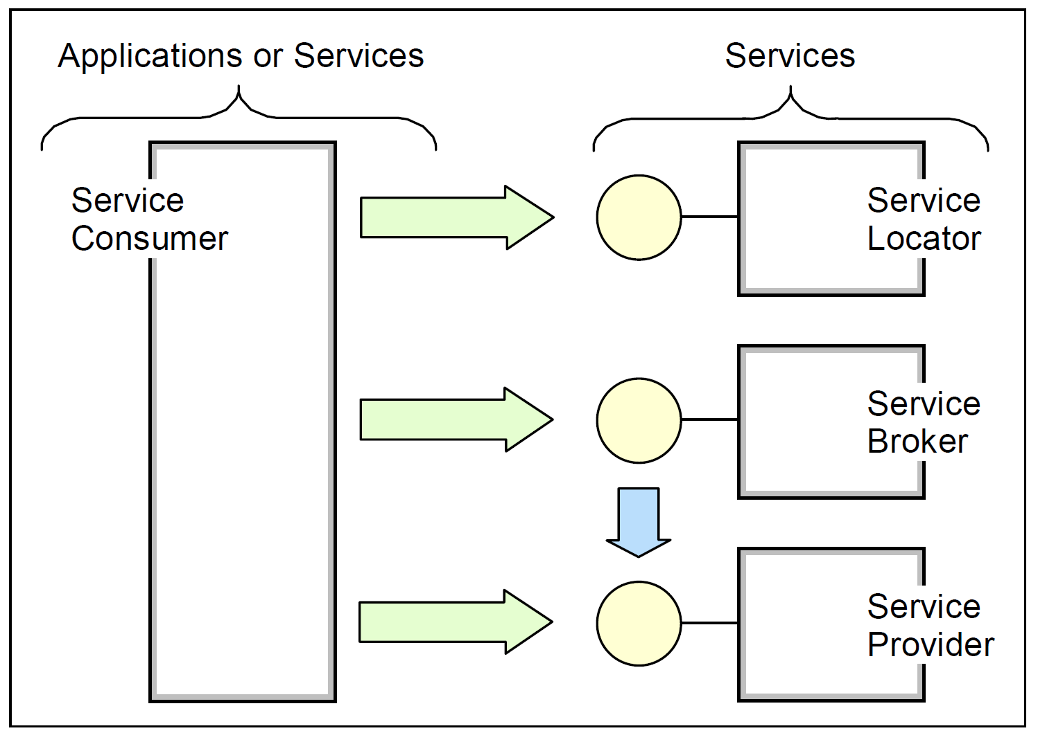
Service-Oriented Terminology (II)

Slide 11
Roles in SOA
Service consumer: The service consumer is an application, a software module or another service that requires a service. It initiates the enquiry of the service in the registry, binds to the service over a transport, and executes the service function. The service consumer executes the service according to the interface contract.
Service provider: The service provider is a network-addressable entity that accepts and executes requests from consumers. It publishes its services and interface contract to the service registry so that the service consumer can discover and access the service.
Service registry: A service registry is the enabler for service discovery. It contains a repository of available services and allows for the lookup of service provider interfaces to interested service consumers.
Each entity in the service-oriented architecture can play one (or more) of the three roles of service provider, consumer and registry.

Slide 12
Operations in SOA
Publish: To be accessible, a service description must be published so that it can be discovered and invoked by a service consumer.
Find: A service requestor locates a service by querying the service registry for a service that meets its criteria.
Bind and invoke: After retrieving the service description, the service consumer proceeds to invoke the service according to the information in the service description.

Slide 13
Artifacts in SOA
Service: A service that is made available for use through a published interface that allows it to be invoked by the service consumer.
Service description: A service description specifies the way a service consumer will interact with the service provider. It specifies the format of the request and response from the service. This description may specify a set of preconditions, post conditions and/or quality of service (QoS) levels.

Slide 14
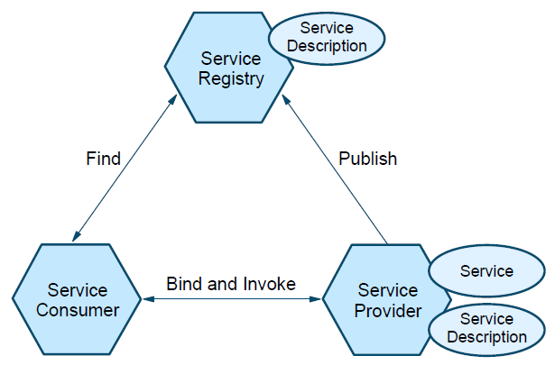
Collaborations in SOA

Slide 15
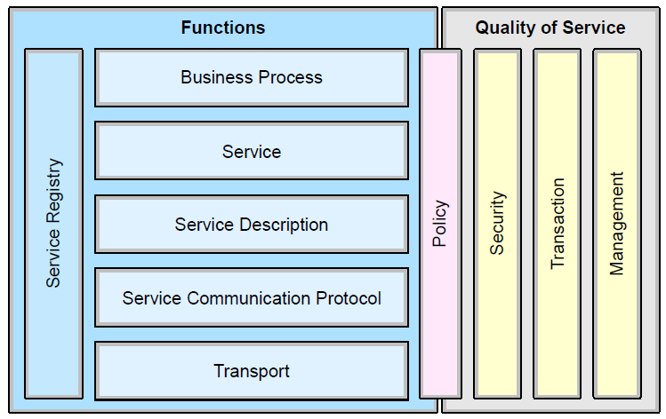
Elements of a SOA

Slide 16
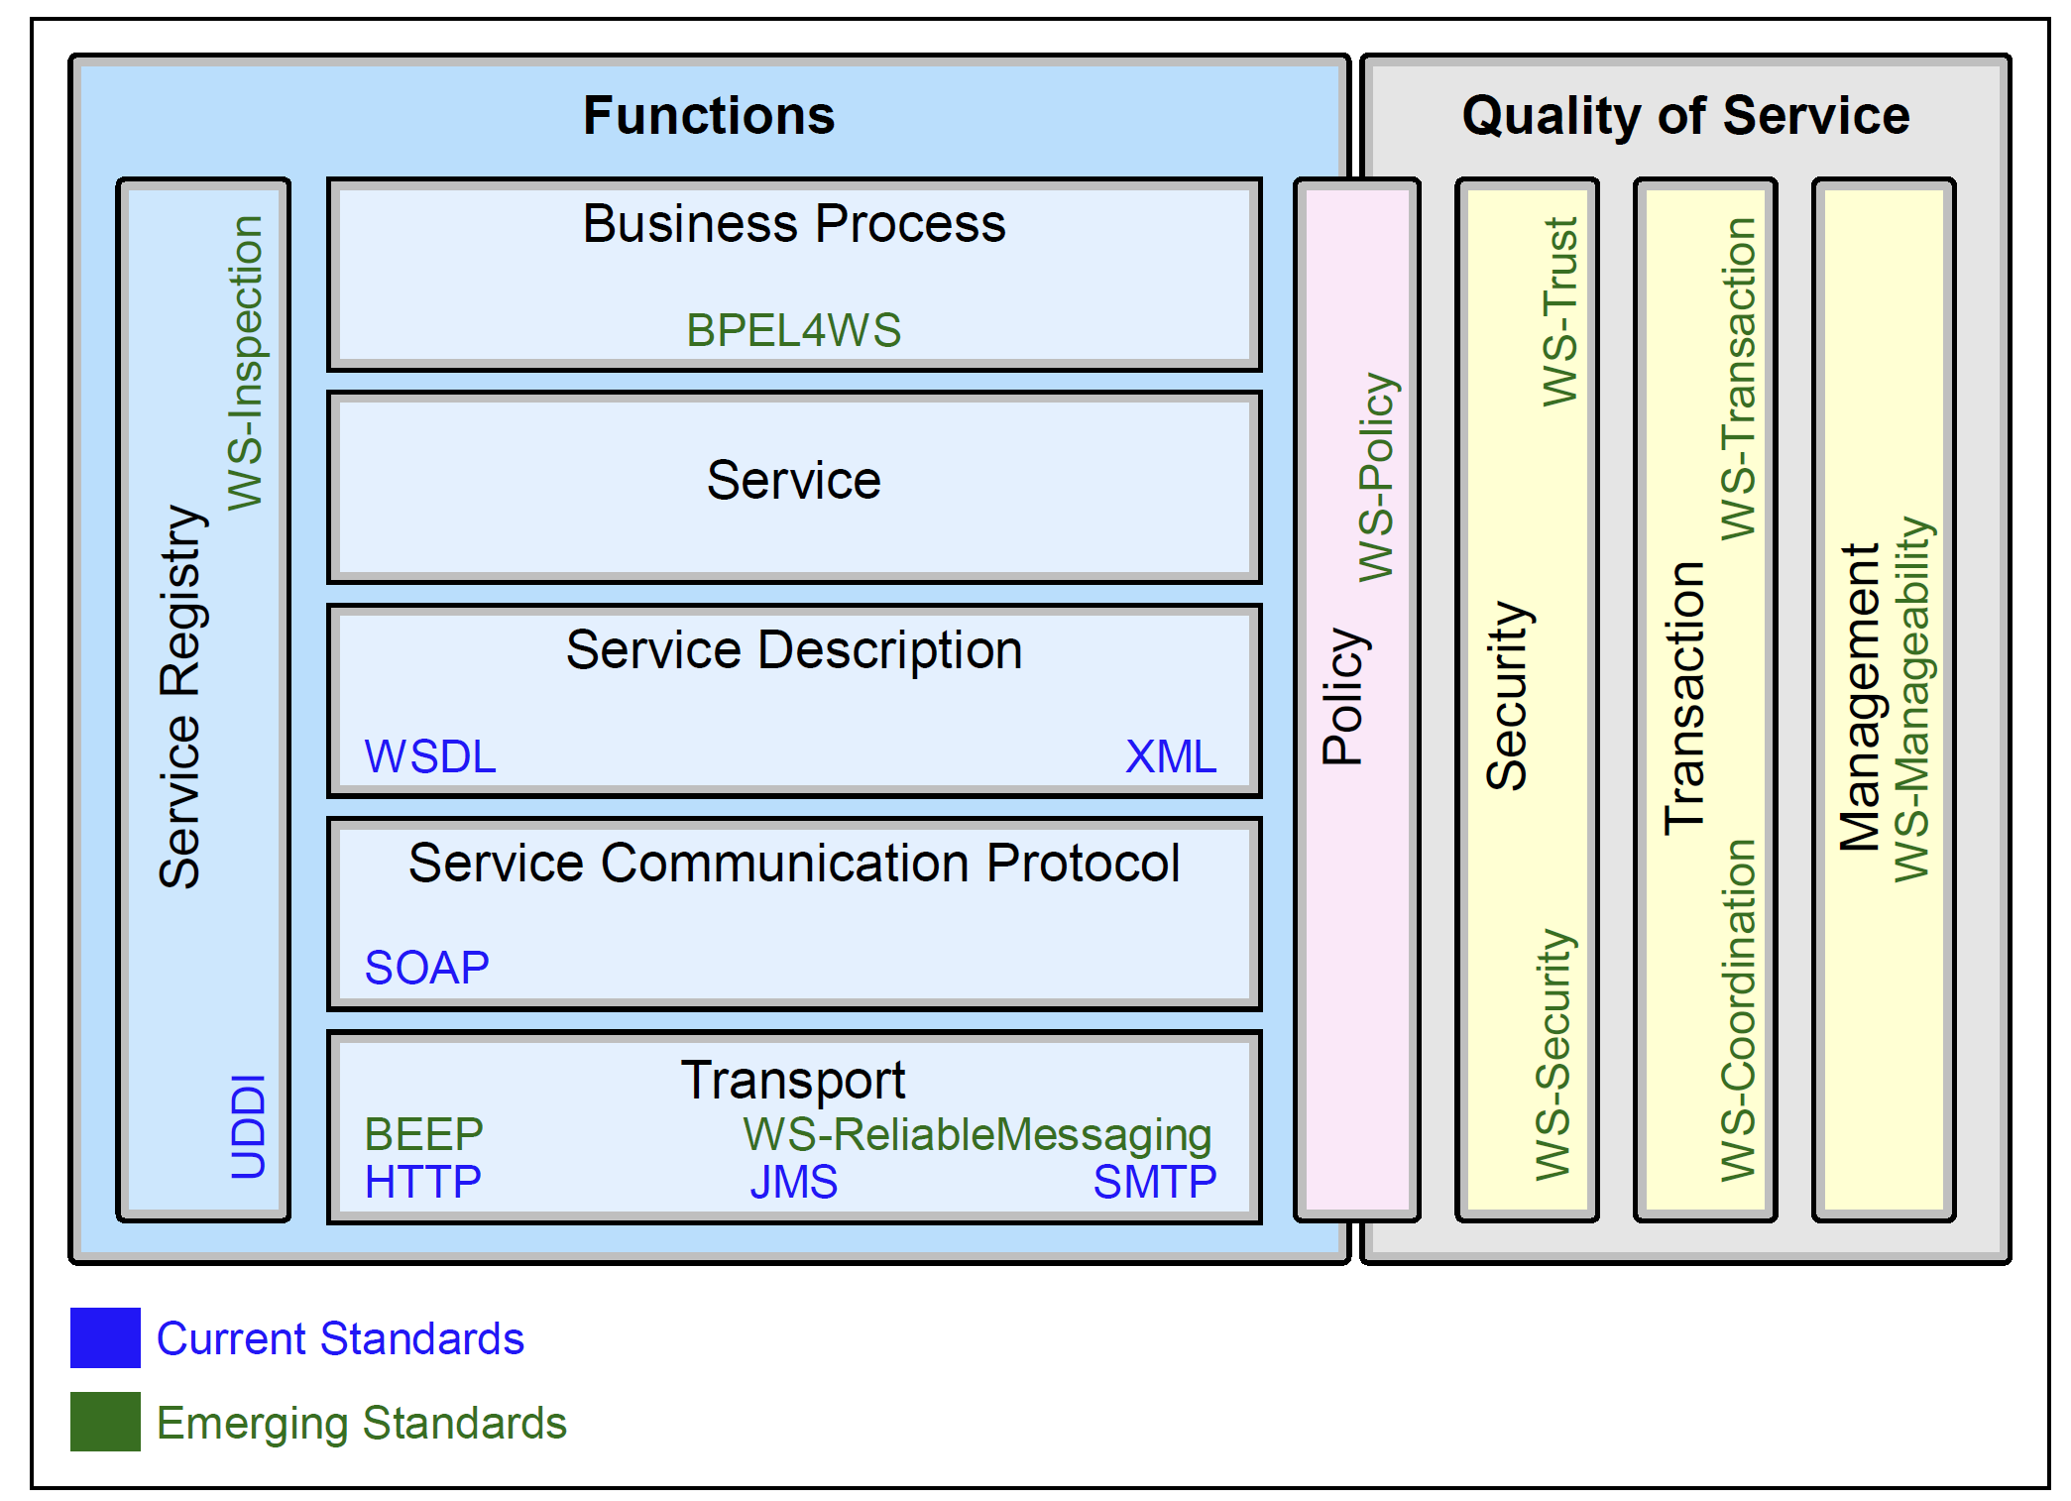
Technology Options

Slide 17
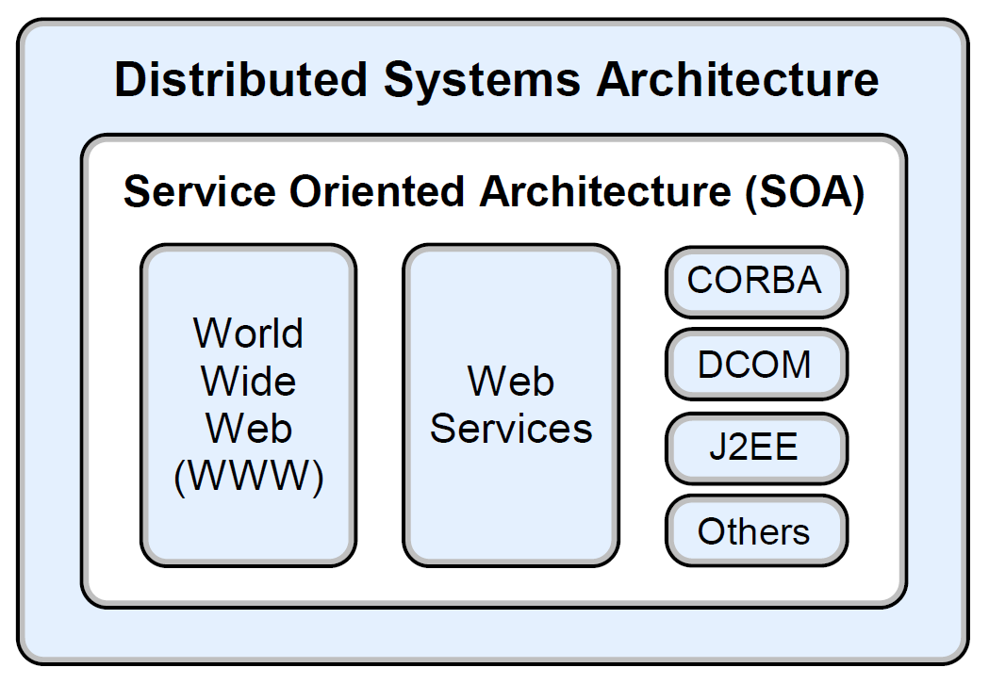
Different Implementations of SOA
Examples of technologies that are at least partly service-oriented include CORBA, DCOM and J2EE.
Early adopters of the service-oriented architecture approach have also successfully created their own service-oriented enterprise architectures based on messaging systems such as IBM WebSphere MQ.
Most recently, the SOA arena has expanded to include the World Wide Web (WWW) and Web Services.

Slide 18
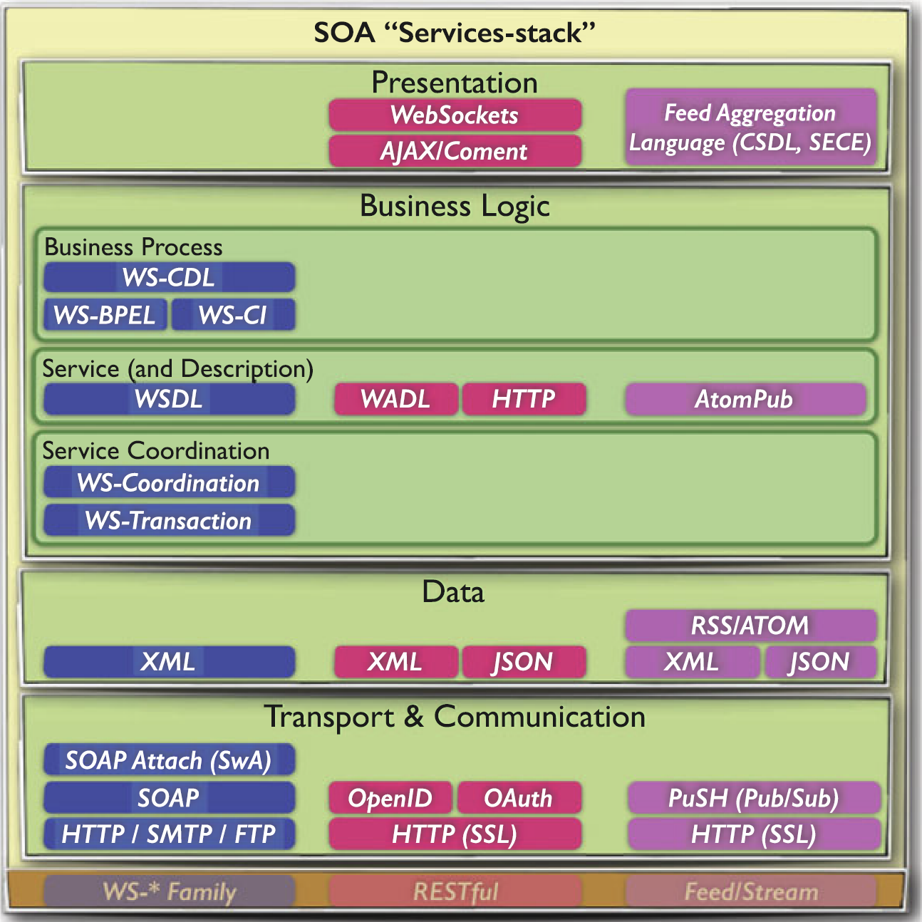
SOA Realization Technologies [3]

Slide 19
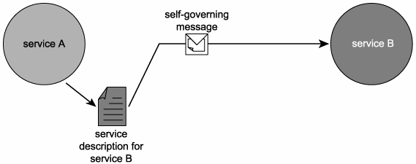
SOA vs. Distributed Architectures [4]
Services that provide service descriptions and communicate via messages form a basic architecture.
So far, this architecture appears similar to past distributed architectures that support messaging and a separation of interface from processing logic.
What distinguishes ours is how its three core components (services, descriptions, and messages) are designed.

Slide 20
How Services are Designed
Loose coupling Services maintain a relationship that minimizes dependencies and only requires that they retain an awareness of each other.
Service contract Services adhere to a communications agreement, as defined collectively by one or more service descriptions and related documents.
Autonomy Services have control over the logic they encapsulate.
Abstraction Beyond what is described in the service contract, services hide logic from the outside world.
Reusability Logic is divided into services with the intention of promoting reuse.
Composability Collections of services can be coordinated and assembled to form composite services.
Statelessness Services minimize retaining information specific to an activity.
Discoverability Services are designed to be outwardly descriptive so that they can be found and assessed via available discovery mechanisms.

Slide 21
Why SOA?
Improved integration (and intrinsic interoperability)
The cost and effort of cross-application integration is significantly lowered when applications being integrated are SOA-compliant.
Inherent reuse
Leveraging the legacy investment
The cost and effort of integrating legacy and contemporary solutions is lowered. The need for legacy systems to be replaced is potentially lessened.
More responsive and faster time-to-market
Organizational agility.
The cost and effort to respond and adapt to business or technology-related change is reduced.

Slide 22

Thank You & See You Again

